Slide 1
What’s New in Azure Serverless
Abstract: Serverless is a great computing abstraction. When combined with great tools, developers can be more productive than ever. Developers are looking to leverage the new paradigm of serverless architecture: a scalable and reliable event-based compute experience for code and workflows, which accelerate the development of applications while eliminating the need to manage infrastructure, providing fast auto-scale and micro-billing. In this session, we will explore the use of Azure Functions, Event Grid, and Logic Apps for building powerful serverless applications. We will learn how to build, deploy, manage, and monitor those solutions. This session will quickly cover the basics, and finish with a look at the newest features in the Azure Serverless platform.

Slide 2
What’s New in Azure Serverless
Michael S. Collier
Sr. Software Development Engineer
Commercial Software Engineering – Global ISV
@MichaelCollier | www.MichaelSCollier.com

Slide 3
Agenda
What is Serverless on Azure?
Azure Functions
Azure Logic Apps
Azure Event Grid
Q&A

Slide 4
The “evolution” of application platforms
Notes:
All good things begin with a story.
So before I talk to you about serverless, I wanted to discuss some history of how apps have been built through the years and how that has led us to the computing options we have today.

Slide 5
What is the right size of
servers for my business needs?
How do I deploy new code to my server?
What media should I
use to keep backup?
What happens in case of
server hardware failure?
Which packages should be on my server?
What size of servers
should I buy?
Who monitors
my App?
How often should I backup my server?
How can I scale my app?
How can I increase server utilization?
Who has physical
access to my servers?
Which OS should I use?
Do I need secondary network connection?
Are my server in a
secure location?
What happens if the
power goes out?
Who monitors
my Servers?
Do I need a UPS?
What storage I need to use?
How many servers
do I need?
How can I dynamically configure my app?
It takes how long to provision a new server?
How often should
I patch my servers?
On-Premises
The “evolution” of application platforms
Notes:
On-Premises
Buy your own hardware and software
Run it in your own data-centers
Deal with a multitude of questions
# of servers
Physical security
Hardware failure
Software patching
Backup
Essentially a lot of questions, not all of which might be directly related to running your business. For example, if you are running an insurance company, you want to spend your time growing and innovating in the insurance domain, not worrying about how to handle servers.

Slide 6
What is the right size of servers for my business needs?
How can I increase server utilization?
How many servers do I need?
How can I scale my app?
How often should I patch my servers?
How do I deploy new code to my server?
How often should I backup my server?
Which OS should I use?
Which packages should be on my server?
Who monitors my App?
On-Premises
IaaS
The “evolution” of application platforms
Notes:
Along came the cloud, and provided some relief from some of those questions.
IaaS in the cloud, allowed you to forget about managing all that physical hardware. Instead of hosting it yourself, you could now utilize servers hosted by someone else. While the worries around managing physical infrastructure are gone, there are a number of questions that still need to thought about:
How many virtual machines do I need?
How many would I need in future when my usage grows?
How to handle updating the servers for the latest security patches
How to think about deploying my code and the various dependencies, such as application runtimes, to the server
Who monitors my apps and so on
This means that you still haven’t reached that ideal state where you could focus purely on your business and its problems.

Slide 7
What is the right size of “servers” for my business needs?
How can I increase “server” utilization?
How many “servers” do I need?
How can I scale my app?
On-Premises
IaaS
PaaS
The “evolution” of application platforms
Notes:
Well, the cloud continue to help with that problem and with the advent of PaaS, there was even more simplification. PaaS allows you to just worry about your app, and let the cloud vendor take care of not only the physical hardware, but also the ongoing management of the operating environment like Operating Systems, Virtual Machines or Containers, as well as the various application runtimes, whether it is Java Runtime, .NET, Node.js, and so on.
You are not completely free from thinking about servers however, since you still have to worry about how to scale your app and accordingly specify the number and size of the various compute resources your apps would need at various times.

Slide 8
How do I architect my app?
Serverless, the platform for next gen apps
On-Premises
IaaS
PaaS
Serverless
The “evolution” of application platforms
Notes:
The latest in this series of evolution is Serverless – which further abstracts the underlying infrastructure from you, and allows you to focus only on a single question – how are you going to build your app to achieve the best results for your business, or whatever it is that you are trying to do with your apps.
Whether it is the code to delight your customers through a great experience, or the logic to communicate securely with a business partner, that is where most organization want to spend their creative energies on.
And serverless allows you to do just that, focus on your code and forget about the infrastructure.
This is why we believe it is the platform for next generation of apps.

Slide 9
What is “serverless”
Abstraction of servers
Event-driven scale
Sub-second billing
Notes:
Abstraction of servers, infrastructure and configuration of operating system
Event-driven scale
Sub-second billing
Stateless

Slide 10
Benefits of “serverless”
Micro-pricing
Ease of scale
Manage less

Slide 11

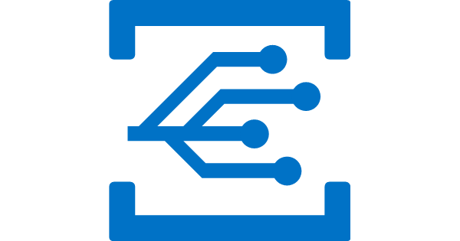

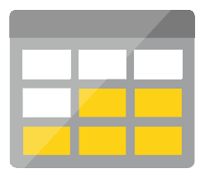
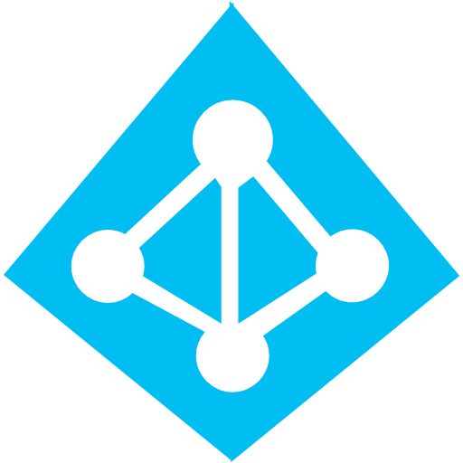


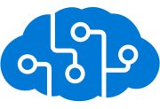
Serverless application platform components
Development
Platform
IDE support
Event Grid
Logic Apps
Functions
Manage all events that can trigger code or logic
Design workflows and orchestrate processes
Execute your code based on events you specify
Integrated DevOps
Local Development
Monitoring
Database
Storage
Security
IoT
Analytics
Intelligence
Visual Debug History
Notes:
What’s the process like to build serverless applications? What does the developer experience look like?
For serverless apps, we provide full E2E development experience through tools like Visual Studio and VS Code. We in fact support unique features like the ability to build, test and debug your applications locally on your dev machines, before even deploying them to the cloud. This is a massive productivity boost while building cloud apps!.
These technologies support continuous deployment so you can easily integrate them into your existing deployment pipelines.
And finally, we provide full monitoring support through Azure Application Insights to monitor your apps in production

Slide 12
Scenarios for Serverless
Anything that needs to respond to events
Real-time stream processing
Timer-based processing
Millions of devices feed into Stream Analytics
Transform to structured data
Store data in SQL DB
Every 15 minutes
Find and clean invalid data
Clean table
Backends (Mobile/IoT/Web)
Real-time bot messaging
?
...
Photo taken and WebHook called
Stores in blob storage
Produces scaled images
Message sent to Chatbot
Chatbot sends
response
Cortana Analytics answers questions
Notes:
So what kind of apps and scenarios can be built using serverless technologies? This is not a trick question because I have already given you the answer.
Anything where there is need to run some code or logic in response to an event. You will notice that this is a very broad definition and covers a vast array of scenarios. So let me provide some examples:
Real-time stream processing: IoT devices sending data that needs to be analyzed, enriched and archived somewhere. This is best done using serverless functions which can be spun up on demand, because you don’t know when the data is going to come in and how much data is going to come in. So, you don’t necessarily want to build your own infrastructure for peak capacity.
Almost every organization needs to run some regular tasks like de-duplication of database entries at the end of every day or collecting logs at the end of every week. Such tasks that need to be run only at specific times and only for a few seconds each time, don’t call for dedicated infrastructure. They are best left to serverless solutions.
Building backends for your mobile, IoT or even web apps is also a popular use-case for serverless architectures: In this diagram you see a mobile app sending an image to a function which stores it in Azure Storage. This action triggers another function which creates multiples thumbnails out of the original image. Being able to perform these action in a serverless manner, takes away the burden of the mobile developer from worrying about the backend.
Bots are all the new rage: Automated response systems receiving a customer request is an event. Building intelligent bots for such scenarios using serverless technology is again a great example where the focus needs to be on logic instead of infrastructure.
These are only some of the many examples which fit well with serverless.

Slide 13
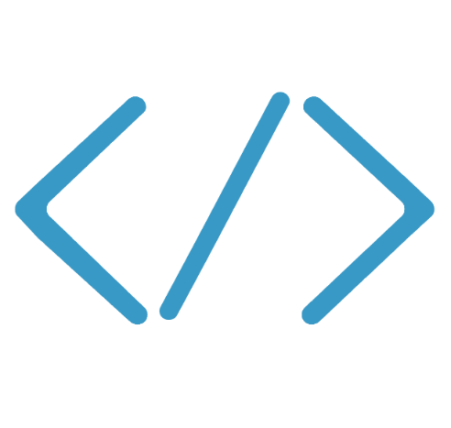

Functions
Code
Azure Functions
Events & Data
Develop locally using best of class developer tools
Boost productivity through triggers and bindings
Choose from a variety of programming languages
Integrate with existing DevOps processes
Notes:
Functions provide an experience of responding to events through code that in turn processes data that could be coming from or headed to any number of services.
Some of the key highlights are:
Ability to build, test and debug your Functions code locally on your own machine before your code is even deployed to the cloud. This is a massive productivity benefit while building cloud applications and something Azure provides through rich integration with a world class developer tool like Visual Studio
Secondly, unique features like triggers and bindings that make it super easy to setup event-driven architectures and simplify communication with data sources
Thirdly, we support a number of programming languages. In the demo we saw an example with C#. But we also support Node.js, F#, Python and even bash so you can pick the language of your choice to write serverless functions with
Lastly, Functions support concepts such as Continuous deployment, which makes it super easy to integrate them into your existing DevOps pipelines.

Slide 14

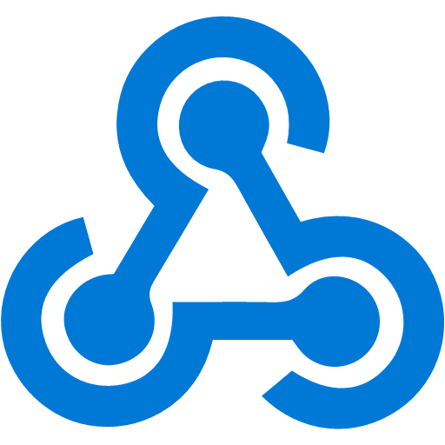




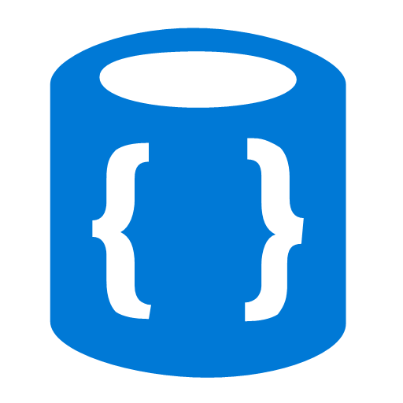


Azure Functions
Events
Code
Outputs
React to timers, HTTP, or events from your favorite Azure services, with more on the way
Author functions in C#, F#, Node.JS, Java, and more
Send results to an ever-growing collection of services
Notes:
To put it another way, Functions react to events – timer event, HTTP event, or events from a wide range of Azure services.
You write code to respond to the event. What do you want to do now that you have the data?
You decide what you want to do – send it to storage, send an SMS message, etc.

Slide 15
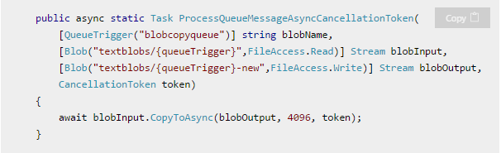
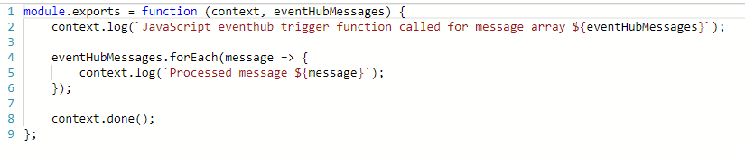
What is the “Functions” programming model?
Function as the unit of work
Functions are executed; they start and finish
Functions have triggers
Functions can have inputs and outputs (bindings)
Notes:
First, a simple event hub JS function (just trigger)
Then, a good example of a C# function with a trigger and input/output bindings

Slide 16
Language Support
Language | 1.x | 2.x | Notes
C# | GA | Preview | C# Script and Class Libraries
JavaScript | GA | Preview | Node, 6.50 (1.x) and >=8.4.0 (2.x)
F# | GA | Preview | F# Script and Class Libraries
Java |  | Preview | Maven, Jenkins, Eclipse, VS Code Supported
Python | Experimental | Soon
Bash | Experimental
PowerShell | Experimental
Batch | Experimental
PHP | Experimental
TypeScript | Experimental
Experimental languages don’t scale well & limited binding support; no official support.
Notes:
https://docs.microsoft.com/en-us/azure/azure-functions/supported-languages

Slide 17
Demo
Functions
Notes:
1 – Show HelloWorld
2 – Show ImageAnalyzer

Slide 18



Function Proxies
Customers
customers.azurewebsites.net
Present a single API surface
Modify requests & responses
Mocking
Lightweight API Management
Products
products.azurewebsites.net
API calls
Orders
orders.azurewebsites.net
Function app B
/products
Function2
Function app A
/customers
Function1
/products
Function app C
/orders
/orders
Function3

Slide 19

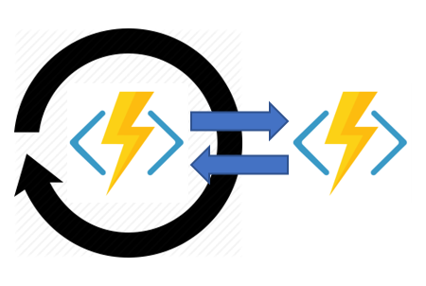
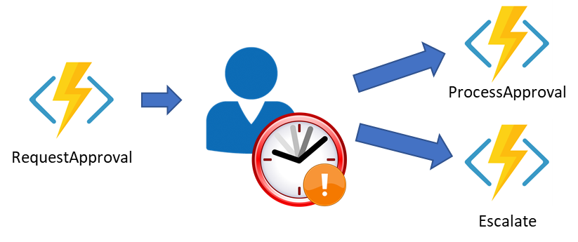
Durable Functions
1
F1
F2
F3
F4
Extension of Azure Functions & WebJobs
Orchestrator Function
Call functions sync/async
Automatic checkpoints
2
3
Start
DoWork
F1
F3
F2
GetStatus
4
5
Notes:
1 – Function Chaining
2 – Fan-out / fan-in
3 – Async HTTP APIs
4 - Monitoring
5 – Human interaction
https://github.com/Azure/azure-functions-durable-extension/releases

Slide 20
Durable Functions
Orchestrator
Activity Functions
F1
F2
F3

Slide 21
Demo
Durable Functions

Slide 22





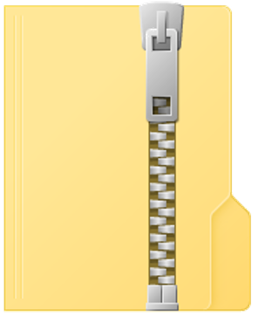
What’s new in Azure Functions
Trigger a function based on changes in Cosmos DB
Database
Containers
Functions on Linux & Docker
Functions
Long running, stateful functions
Execute your code based on events you specify
Durable Functions GA (v1)
HTTP Trigger performance improvements
Faster Scale-Out
Application Insights Monitoring
AI is enabled by default
Tighter integration with Event Grid
Event Grid
Deployment
Zip-push
Notes:
https://docs.microsoft.com/en-us/azure/azure-functions/deployment-zip-push#deployment-customization

Slide 23
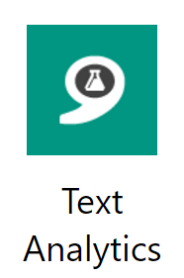
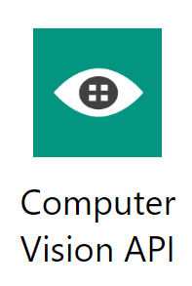
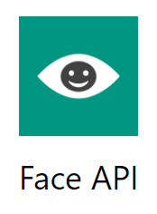
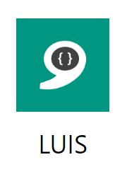

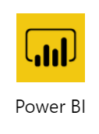

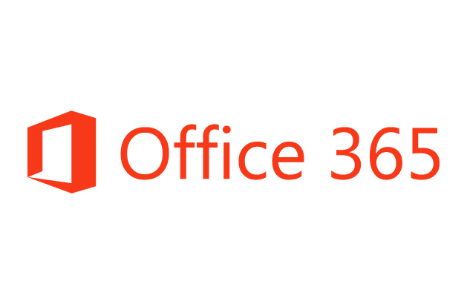

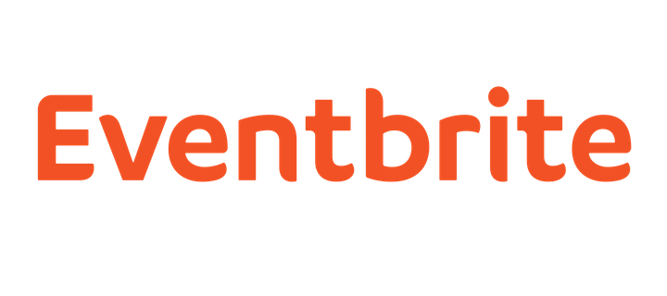












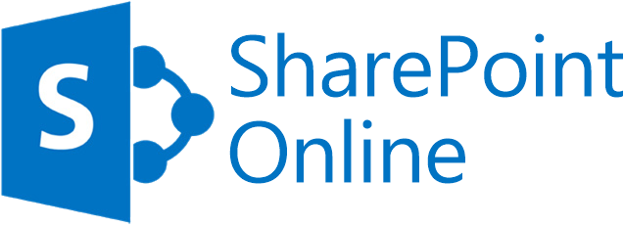



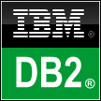


Logic Apps connects everything*
Azure API Management
Azure Service Bus and Event Grid
Azure Functions
Azure Active Directory
Azure App Services
Azure Blob
Azure CosmosDB
Azure Data Lake
Azure SQL
Azure Resource Manager
Logic Apps
On-premises data
gateway
BizTalk Server
* Everything is a lot! There are more than 200 connectors and ability to create custom connectors.
Notes:
Let’s talk about another Azure Serverless component – Logic Apps.
Logic Apps enables you to build workflows and connections to various services without the need to write a lot of code. It removes some of the tedious plumbing code and lets you focus on the logic.
Logic Apps support more than 180 connectors already. It goes without saying that it supports most Azure services but you can see from this list that it also supports many popular 3rd party services like Dropbox, Twitter, Salesforce and so on.
And it does that without requiring you to understand how any of these other services work. It completely abstracts the integration details of how to communicate with these other services and their specific API, SDKs and protocols.

Slide 24
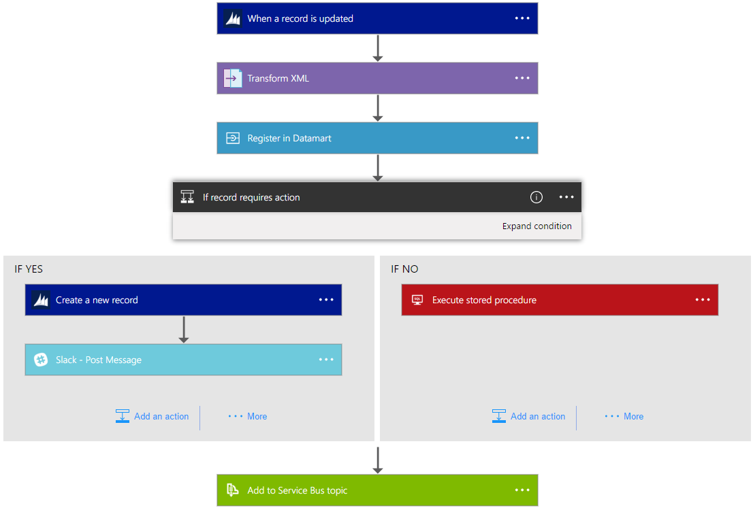
Logic Apps Workflow Designer
Workflow in the cloud
Powerful control flow
Connect disparate applications
No code designer for rapid creation
Also works within Visual Studio for added CI/CD
Notes:
Your entry point to Logic Apps will likely be the Workflow Designer.
Provides a visual design experience for creating serverless workflows in the cloud without writing any code.
No matter how complex your business logic is, you can express it using the powerful control flow available in Logic Apps.
Another key value of this service is that, it provides connections with multiple services and allows you to orchestrate all these services along with the functions which you or someone else in your organization might have written.
Lastly all of these workflows are internally represented using a declarative definition format, again making it very friendly with your existing CI/CD practices

Slide 25
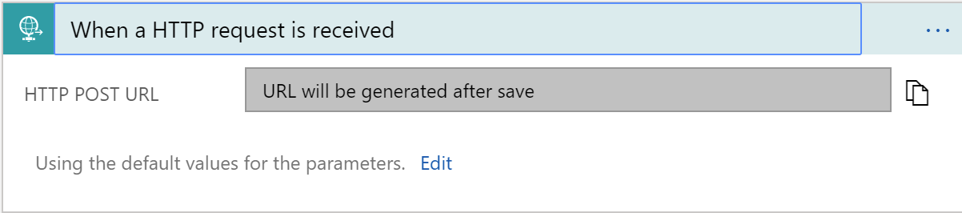
Triggers
All logic apps start with a trigger, typically a connector
Recurring and Adv. Scheduling
Polling
Webhook
Request

Slide 26
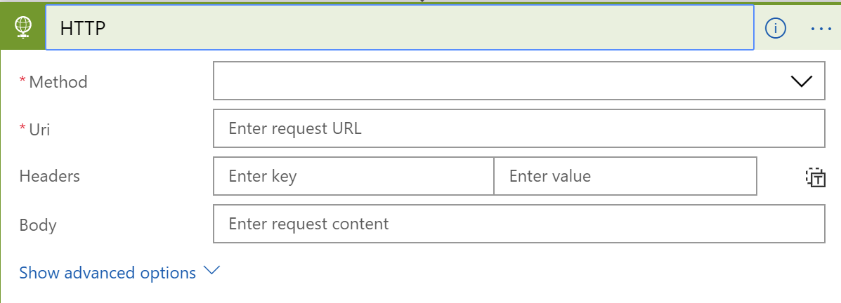
Actions
All logic apps continue with actions, which is also most of the time, a connector
Invoke APIs and Services
Behaviors
Variables
Expressions and Operators

Slide 27
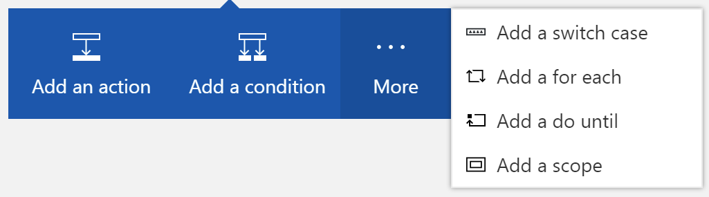
Workflow Features
To control your logic app's workflow, you can specify different paths for your logic app to run and how to process data in arrays, collections, and batches

Slide 28
Demo
Logic Apps
Notes:
Show image processing logic app
Watch for files
Analyze with computer vision
Create thumbnail with computer vision
Send text message

Slide 29
Azure Event Grid
Fully-managed event routing
Near real-time event delivery at scale
Broad coverage within Azure and beyond
Backbone of event-driven computing
Notes:
Now, I would like to spend some time discussing the newest member of the Azure Serverless family, Azure Event Grid.
If you’ve done any UI work in the past, you might be familiar with delegates and event-driven programming. This has been a solved problem for a long time within application, now it is finally coming to the cloud.
Event Grid provides a fully-managed event routing service – all your events in one place, completely managed.
Sub-second e2e latency in the 99th percentile, which is as close to real-time delivery as it gets. It also has the ability to route about 10 million events per second, so massive scale
Events for Azure services, or custom ones as well.
All of these make Event Grid a very powerful event backbone for your serverless applications.
In terms of performance and scale, Event Grid makes some strong guarantees.
Sub-second e2e latency in the 99th percentile, which is as close to real-time delivery as it gets
An ability to route about 10 million events per second, so massive scale
And, an intelligent logic to retry the event delivery if the first time doesn’t succeed
All of these make Event Grid a very powerful event backbone for your serverless applications.

Slide 30

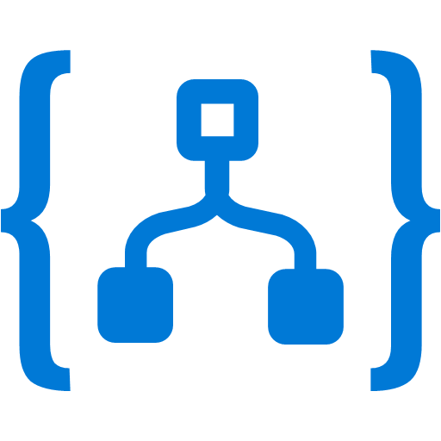
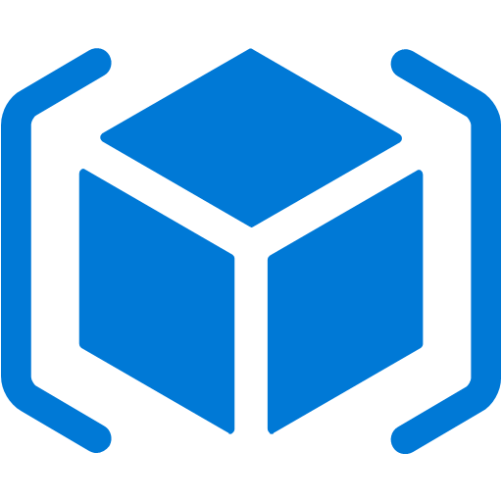


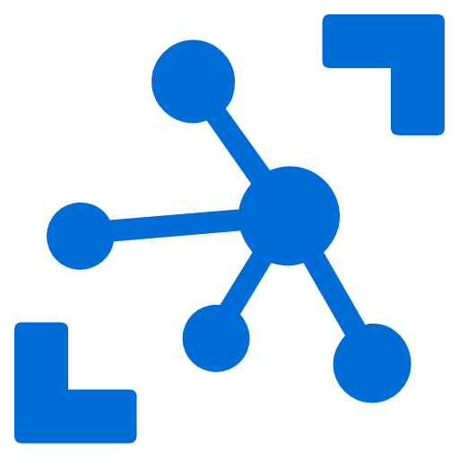

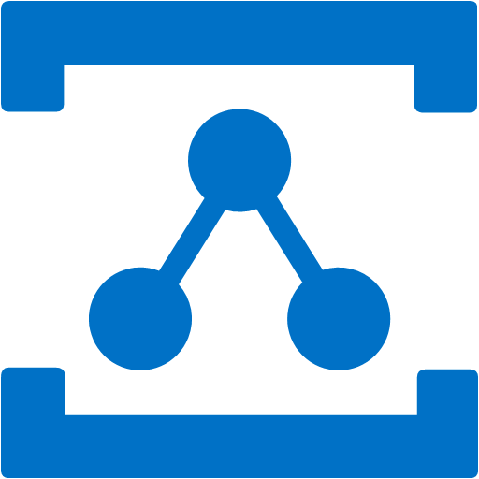


Event Grid
Event publishers
Event handlers
Blob Storage
Manage all events in one place
Focus on innovation and pay per event
Unlock new scenarios for your apps
Ensure reliability and performance for your apps
new
Azure Functions
Storage (GPv2)
Logic Apps
Resource Groups
Azure Automation
Azure Subscriptions
Event Hubs
WebHooks
new
new
Service Bus
Event Hubs
new
new
Storage Queue
IoT Hub
new
Relay Hybrid Connection
Custom Topic
new
Topics
Media Services
Event Subscriptions
Notes:
We already talked about how important events are.
This service allows you to manage all events in a single place
Notice that multiple Azure services today publish their events into Event Grid and these events can be routed to multiple destination. We have Functions, Logic Apps and even other services like Automation and generic webhooks.
You can also create your own custom events
The rich set of publishers and consumers opens up many interesting scenarios for you to construct already. And the list of services that will publish their events to Event Grid will continue to grow over time.
https://azure.microsoft.com/en-us/blog/azure-service-bus-now-integrates-with-azure-event-grid/

Slide 31
Event Schema
[{
"topic": "/subscriptions/{subscription-id}/resourceGroups/ascend/providers/Microsoft.Storage/storageAccounts/mcollierascend",
"subject": "/blobServices/default/containers/sample/blobs/michael.collier.jpg",
"eventType": "Microsoft.Storage.BlobCreated",
"eventTime": "2018-03-08T02:32:32.3138466Z",
"id": "60b827dd-701e-010a-2e85-b6ba5f0618c4",
"data": {
"api": "PutBlockList",
"clientRequestId": "580ebc71-0b38-4e13-9c3e-5db169ad2032",
"requestId": "60b827dd-701e-010a-2e85-b6ba5f000000",
"eTag": "0x8D5849CD8572590",
"contentType": "image/jpeg",
"contentLength": 687245,
"blobType": "BlockBlob",
"url": "https://mcollierascend.blob.core.windows.net/sample/michael.collier.jpg",
"sequencer": "0000000000000000000000000000043C00000000004b90e3",
"storageDiagnostics": {
"batchId": "11c2a1b3-013f-4c7a-a31e-cf455a2c7d3f"
}
},
"dataVersion": "",
"metadataVersion": "1"
}]
Properties specific to the publisher
https://docs.microsoft.com/en-us/azure/event-grid/event-schema
Notes:
What does an event look like? It’s really pretty basic.
https://github.com/Azure/azure-rest-api-specs/tree/master/specification/eventgrid/data-plane
https://docs.microsoft.com/en-us/azure/event-grid/event-schema

Slide 32
Validation
[{
"id": "d81e1cee-cd14-4bf6-8105-13cdc71284b3",
"topic": "/subscriptions/xxxxxxx/resourceGroups/cbus-eventgrid/providers/microsoft.eventgrid/topics/cbus-topic-1",
"subject": "",
"data": {
"validationCode": "BDC0D448-74DC-4E4A-B9B4-EFAB111FF10A",
"validationUrl": https://rp-eastus.eventgrid.azure.net/eventsubscriptions/mysub1/validate?id=BDC0D448-74DC-4E4A-B9B4-EFAB111FF10A&t=2018-05-19T17:42:44.7966715Z&apiVersion=2018-05-01-preview&token=yUW1lFf3PSTWyQruNtQ5vCszJ3SiIcJzBvwYnMlN80A%3d
},
"eventType": "Microsoft.EventGrid.SubscriptionValidationEvent",
"eventTime": "2018-05-19T17:42:44.8123163Z",
"metadataVersion": "1",
"dataVersion": "2"
}]
New – preview feature
https://docs.microsoft.com/en-us/azure/event-grid/security-authentication#webhook-event-delivery

Slide 33
Demo
Event Grid
Notes:
.NET SDK
REST
Custom Topic
Blob Created / Deleted
Azure CLI

Slide 34

What’s new in Event Grid
Added 2 Japan, 2 Australia regions
Cloud Events
Cloud Events
Geographic Availability
Event Grid
Financial Backed SLA
99.99% publish availability
Manage all events that can trigger code or logic
Validation URL
$
Validation
Management & Publish SDKs
.NET, Go, Node, Python, Ruby & Java
24 hr. exponential back off
Retry Policy
{ }
Notes:
https://azure.microsoft.com/en-us/blog/better-integrations-and-higher-productivity-with-azure-event-grid/

Slide 35

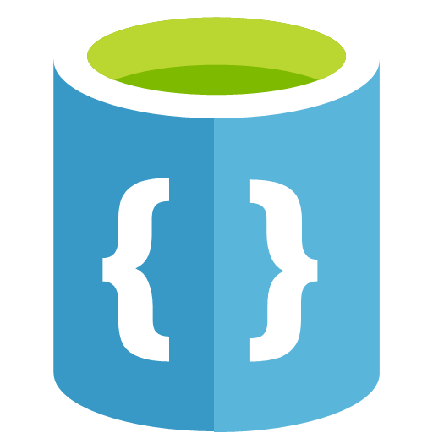

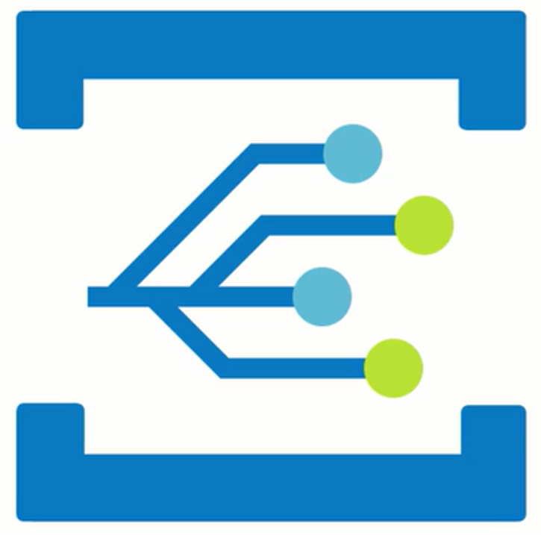
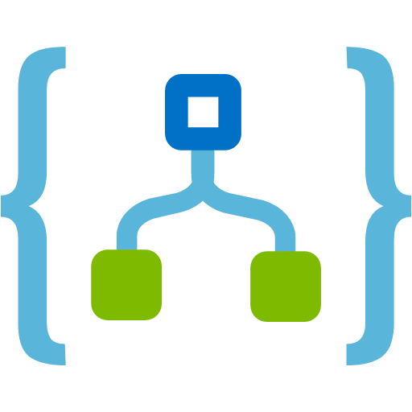
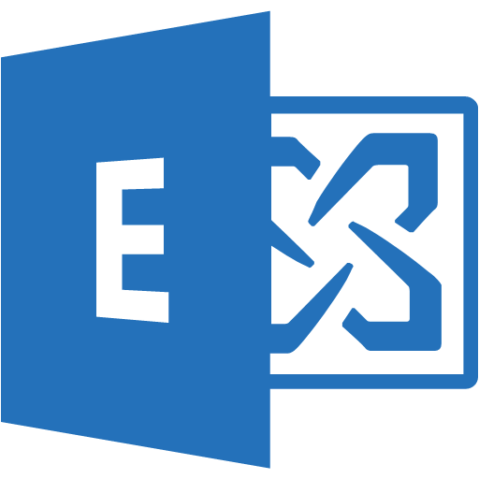
Demo – Altogether
Website - SPA
Website Backend
Proxy
Car Review
GetCars
CreateCar
UploadFile
User
Try it at
http://github.com/Azure-Samples/customer-car-reviews
Blob Storage
Cosmos DB
Reviews Service
Event Grid
Logic App
Office 365
Content Moderator
ChangeFeed
CheckImage
CheckText
SendEvent
Computer Vision

Slide 36
Resources
https://aka.ms/serverless-demos
Event Grid
http://azure.com/EventGrid
Functions
https://docs.microsoft.com/en-us/sandbox/functions-recipes/
https://github.com/Azure/Azure-Functions
https://github.com/Azure/Azure-Functions/wiki/Consumption-Plan-Cost-Billing-FAQ
https://github.com/Azure/azure-functions-host/wiki/Assembly-Resolution-in-Azure-Functions
http://markheath.net/post/azure-functions-choices
https://github.com/mcollier/PRESENTATION-WhatsNewInAzureServerless

Slide 37
BUILD 2018 – Serverless Sessions
Title | Code | Presenters | Video
What's new for Serverless Computing in Azure​ | BRK2137​ | Nir Mashkowski, Ravi Prattipati​ | https://www.youtube.com/watch?v=gSEz7ppOB_Q
Event Grid Unplugged - Using events as the fuel powering your applications​ | THR2038​ | Bahram Banisadr, Dave Beus, James Aldous​ | https://www.youtube.com/watch?v=Bn0N8SYqdU8
Build Nodejs APIs using Serverless​ | BRK3703​ | Simona Cotin​ | https://www.youtube.com/watch?v=837zPKooaaU
Serverless in Action​ | BRK2132​ | Jeff Hollan​ | https://www.youtube.com/watch?v=fPuKaOSjZuA
Connect Anything to Everything: Serverless Routing and Messaging with Event Grid​ | THR3509​ | Jeremy Likness​ | https://www.youtube.com/watch?v=HirD7AkbqBI
Identity and secure resource access in App Service and Azure Functions​ | THR2004​ | Matthew Henderson​ | https://medius.studios.ms/Embed/Video/THR2004?sid=THR2004
Serverless, SPAs, and Scalability​ | BRK3710​ | Asim Hussain​ | https://medius.studios.ms/Embed/Video/BRK3710?sid=BRK3710
Break through the serverless barriers with Durable Functions​ | THR3801​ | Katy Shimizu​ | https://medius.studios.ms/Embed/Video/THR3801?sid=THR3801
Azure Functions and Microsoft Graph​ | THR3302​ | Matthew Henderson​ | https://medius.studios.ms/Embed/Video/THR3302?sid=THR3302
Mobile apps built with Xamarin, using a serverless Azure Functions back-end​ | THR2433​ | Laurent Bugnion​ | https://www.youtube.com/watch?v=R_MHXdcEE9U
Azure Service Bus and Logic Apps for messaging and process automation​ | THR2015​ | Christian Wolf​ | https://www.youtube.com/watch?v=tNB7MMyhADs
Extending DevOps with serverless Logic Apps​ | THR2045​ | Kevin Lam​ | https://medius.studios.ms/Embed/Video/THR2045?sid=THR2045
Zero to hero API development with API Management & Logic Apps ​ | THR2022​ | Miao Jiang, Matthew Farmer​ | https://medius.studios.ms/Embed/Video/THR2022?sid=THR2022
Be an integration genius with Azure and build API-enabled and connected enterprises​ | BRK2113​ | Jon Fancey, Vladimir Vinogradsky, Dan Rosanova​ | https://www.youtube.com/watch?v=I5y0sracIB8

Slide 38


Thank You!

